Slide 1
Image Denoise Using
AutoEncoder

Slide 2
GROUP 04
Shakib Khan
1711661042
Fahim Uddin
1711747042
Iftekhar Alam Pial
1410213642
Md. Niaz Mahmud Shihab 1721274042

Slide 3
SIDD DATASET
Here’s what you’ll find about this dataset :
We provide a small version of the dataset that consists of 320 image (noisy and ground-truth) representing 320 scene instances. These images can be used for training/learning purposes.
The SIDD dataset total size is 6.62GB .
The image shape is (256 x 256 x 3)
Each folder of dataset such as noisy image and ground truth image contains 160 images and 160 images respectively.
Dataset Link : https://www.eecs.yorku.ca/~kamel/sidd/dataset.php

Slide 4
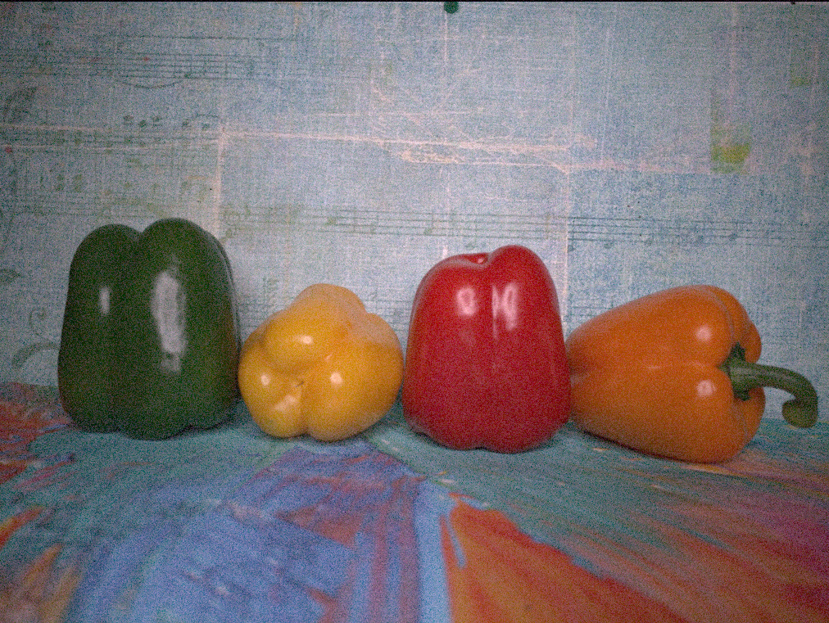
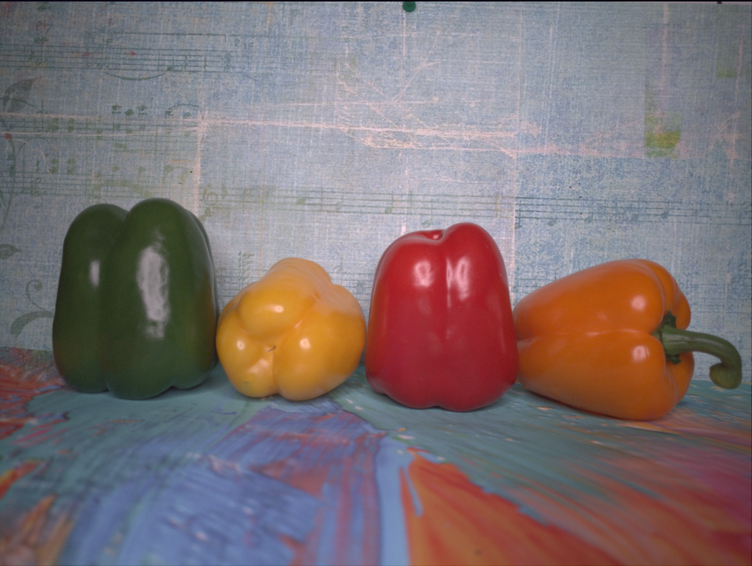
HAVE A LOOK
Noisy Image
Ground Truth Image

Slide 5
DATA SPLIT
Train Data
(Noisy - 128 scene)
(GT - 128 scene)
Test Data
(Noisy - 32 scene)
(GT - 32 scene)

Slide 6
Propose Method
Image Augmentation
AutoEncoder

Slide 7
Image Augmentation
Image Augmentation
Here’s what you’ll find about this Image Augmentation:
For the Flip, flip the image up_down and left_right flip
We rotate the images at 90 degree.
We add hue and brightness to the images.
We add saturation and contrast to the images.
Source of Image Augmentation

Slide 8
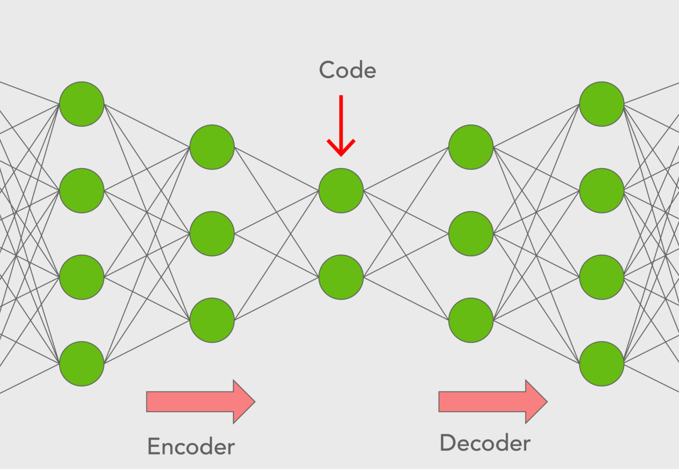
Architecture of Autoencoders
Encoder: An encoder is a feedforward, fully connected neural network that compresses the input into a latent space representation and encodes the input image as a compressed representation in a reduced dimension. The compressed image is the distorted version of the original image.
Code: This part of the network contains the reduced representation of the input that is fed into the decoder.
Decoder: Decoder is also a feedforward network like the encoder and has a similar structure to the encoder. This network is responsible for reconstructing the input back to the original dimensions from the code.

Slide 9
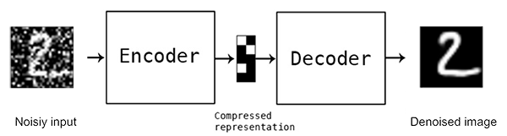
Denoise using autoencoders
Denoising Autoencoder is a modification on the autoencoder to prevent the network learning the identity function. Specifically, if the autoencoder is too big, then it can just learn the data, so the output equals the input, and does not perform any useful representation learning or dimensionality reduction. Denoising autoencoders solve this problem by corrupting the input data on purpose, adding noise or masking some of the input values.

Slide 10
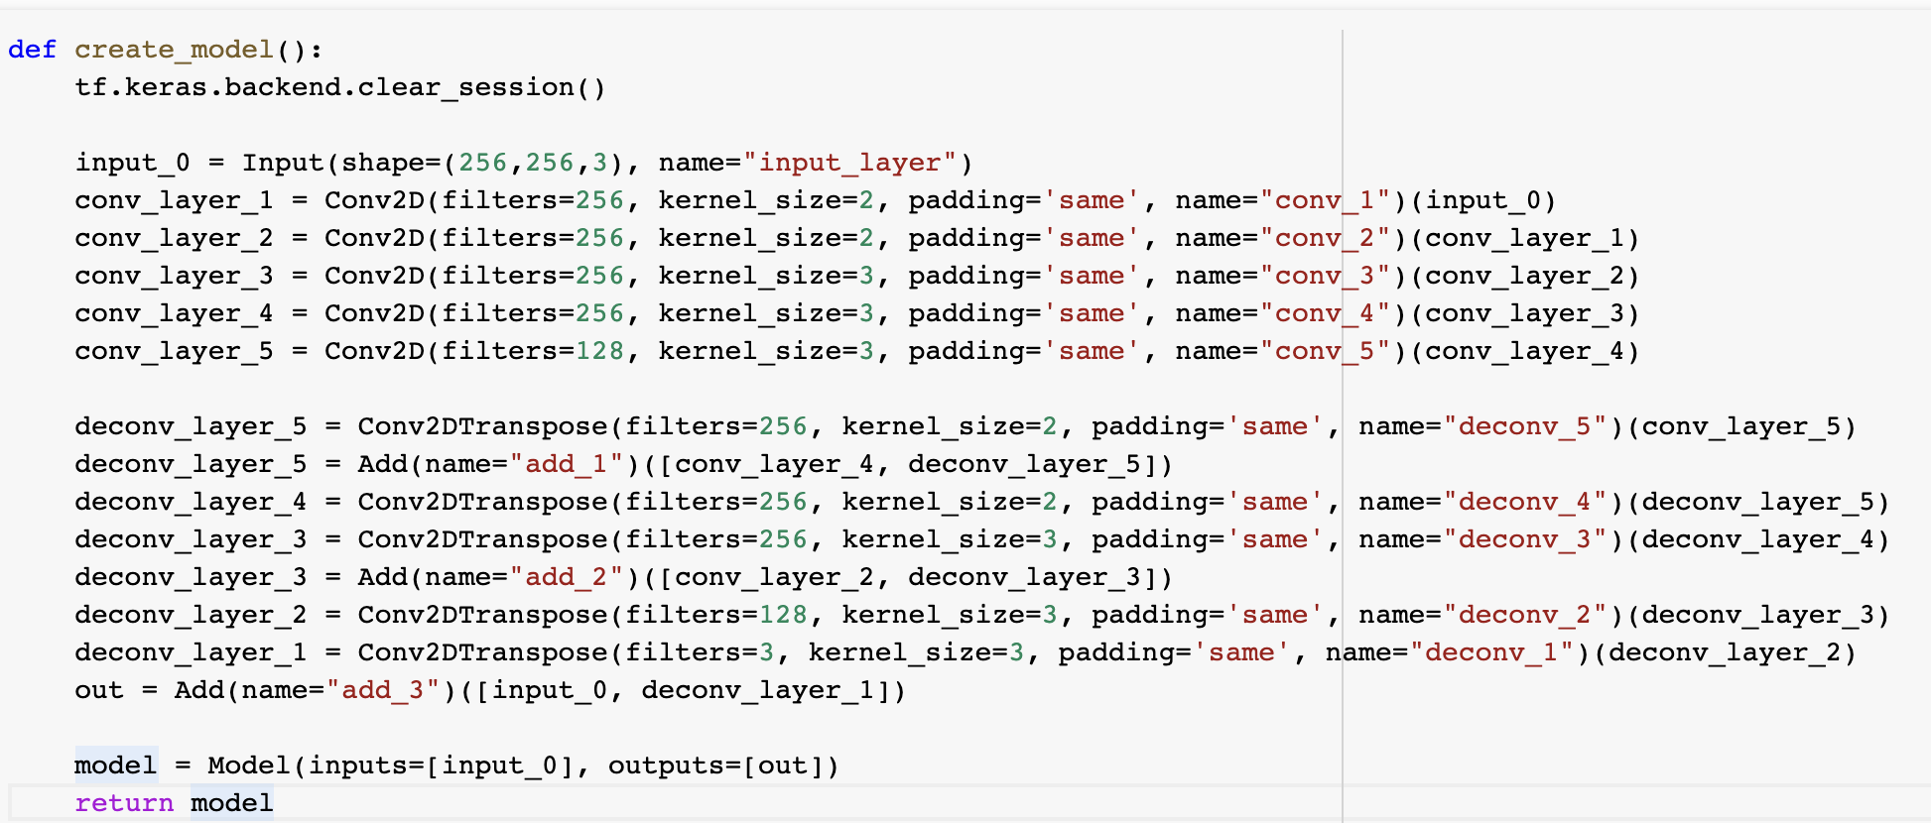
The Code Architecture of autoencoders
Encoder: For the Encoding part we use the Conv2d
Code: For this part of the network we used to add all the information in a reduced representation of the input and that is fed into the decoder.
Decoder: For the decoding part we use the Conv2dTranspose
Source of implementation

Slide 11




LIBRARIES & FRAMEWORK
Numpy
Tensorflow
Keras
Google Colab

Slide 12
DATA VISUALIZATION
Matplotlib
Seaborn
OpenCV
Skimage

Slide 13
OUR PROCESS
01
02
03
Prediction
Data Processing
Build AutoEncoder Model
After train the model we will predict with test data
Rescale our data and normalize them and visualize
Here we train our image data with Autoencoder

Slide 14
EVALUATE LEARNING CURVE
This learning curves of model performance on the train and validation datasets can be used to diagnose an underfit, overfit, or well-fit model.
After training our model we want to see how our model learn from our training data over an epochs.
By Evaluating this, we can tell is our model well-fit or not.

Slide 15
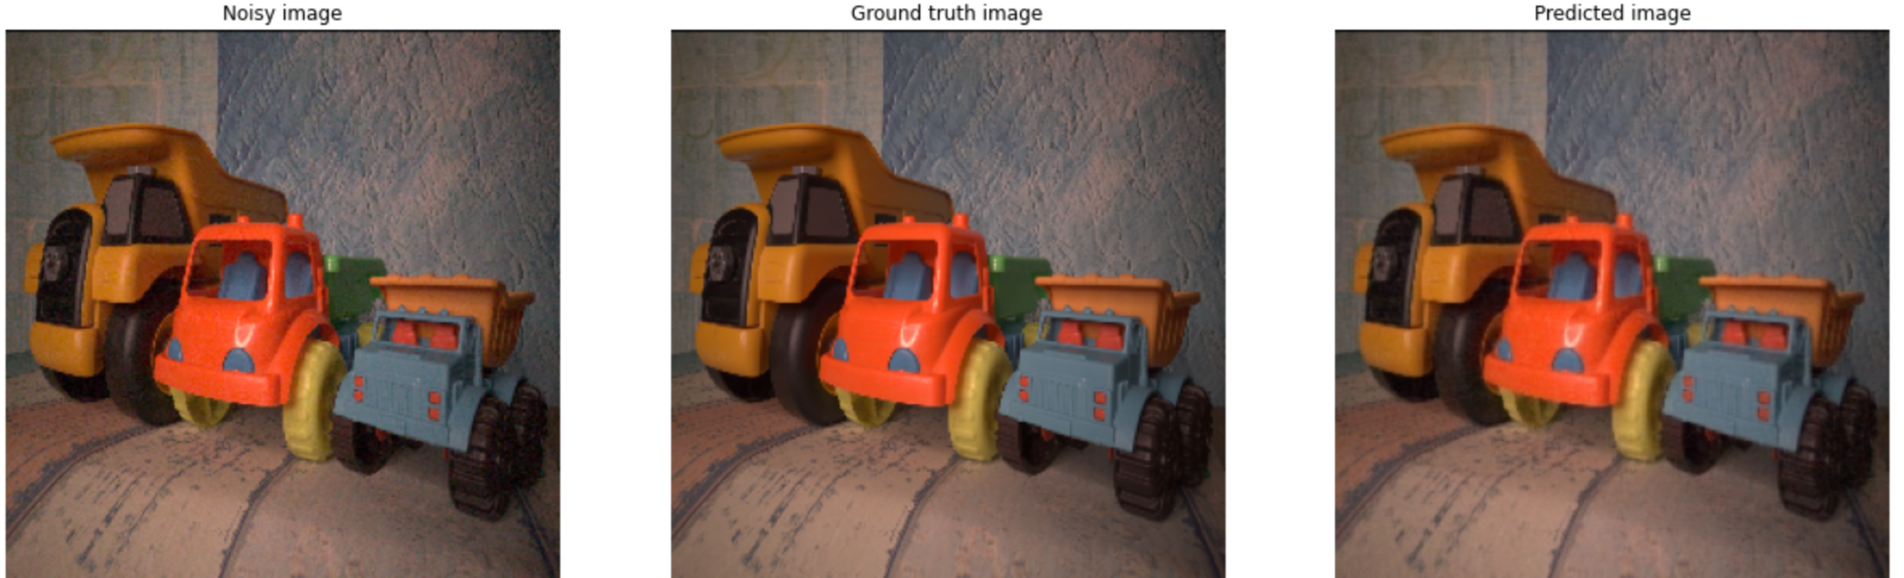
PREDICTION

Slide 16
Project Link
Github : https://github.com/Shakib-IO/CSE445_Machine_Learning
Code Notebook: https://github.com/Shakib-IO/CSE445_Machine_Learning/blob/main/CSE445_ImageDenoiseAutoEncoder.ipynb
Notebook Viewer :If the .ipynb notebook isn’t loading using this url to view the notebook https://nbviewer.jupyter.org/

Slide 17
THANKS

